Slide 1

GROUP 2
Super Store Sales Project
DEPI - POWER BI track
Egypt - 2025

Slide 2

Reham Nagaty (Leader)
Eman Ramadan
Seif Mohamed
Mahmoud Ahmed
Tarek Yehia
Khaled Ahmed
Supervised by
Eng. Kareem Bakli
TEAM MEMBERS

Slide 3

AGENDA
Project overview
Objectives & Business Questions
Data preparation
KPIs & DAX Measures
Dashboard Walkthrough
Key insights
Recommendations
Conclusion & future work
7

Slide 4


Project Overview ...
Dataset:
Retail dataset of sales for global superstore for 4 years.

Slide 5

Why this project matters:
Practice real-world BI workflow.
Develop business-driven insights, not only visuals.
Apply DEPI learning to a complete analytical cycle.
Build a strong portfolio-ready dashboard.
MOTIVATION

Slide 6
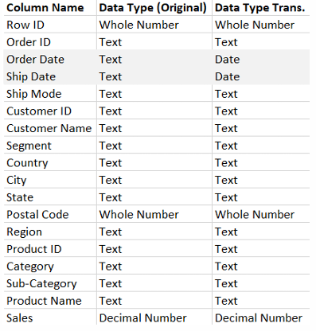
Dataset Info...
Dataset content:
9801 row, 18 columns

Slide 7


Objectives...
Evaluate sales performance over time & regions.
Understand customer behavior (repeat vs new).
Assess product & category performance.
Measure operational efficiency (shipping & processing).
Provide insights that support strategic decisions.

Slide 8
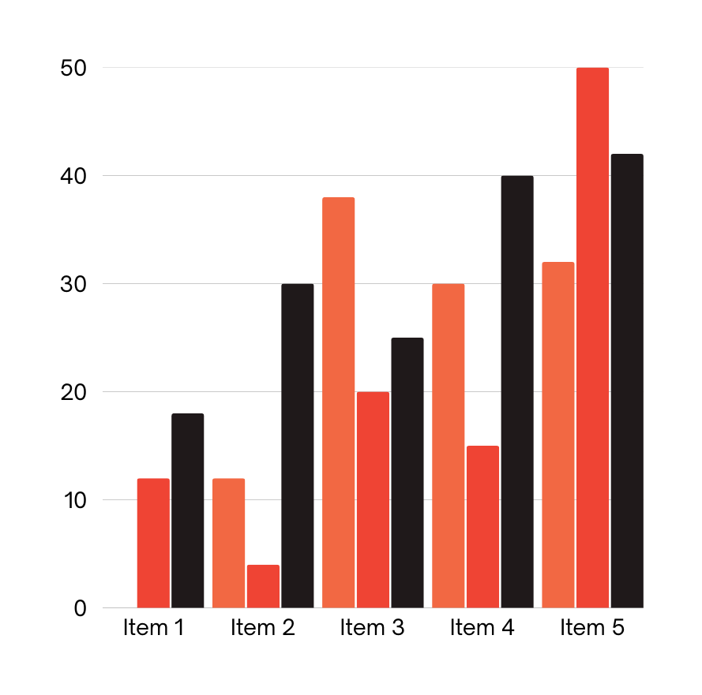
Business Questions ?
How are sales trending over time?
Which products/categories drive the most revenue?
Which regions perform best?
What is the customer retention level?
How efficient is order processing?

Slide 9
Where needs the superstore invest next?
◦ Show growth areas (ex: strong sales in Technology).
◦ Show risks (ex: long shipping times in certain regions).
◦ Suggest opportunities (ex: invest in faster logistics, push profitable
categories, nurture repeat customers).

Slide 10
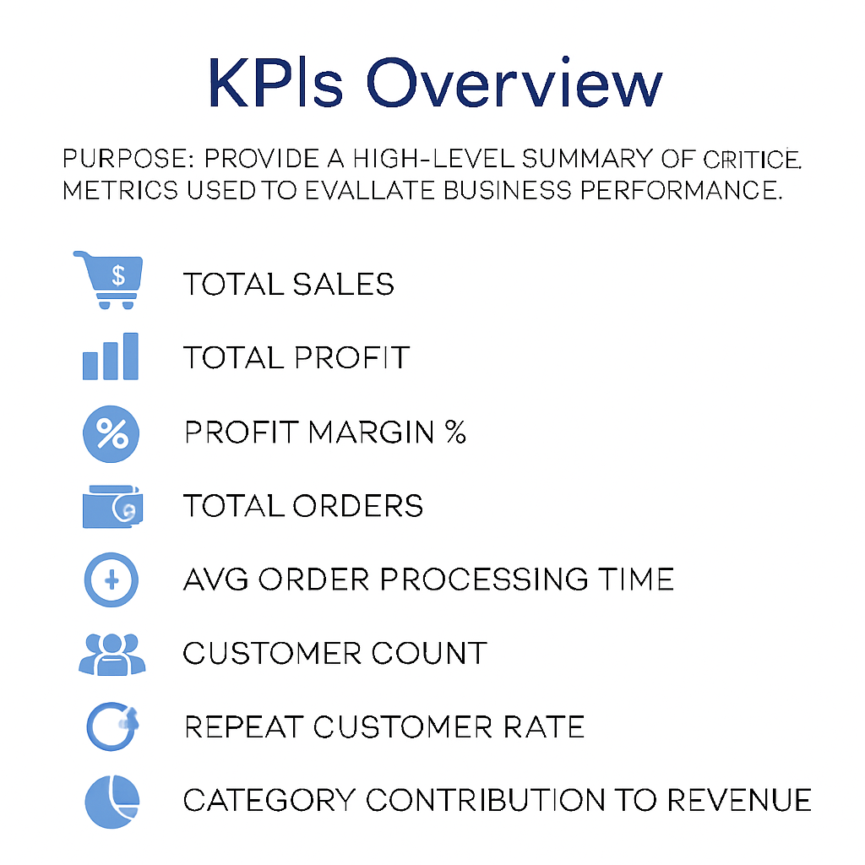


KPIs Overview
Total Sales
Total Profit
Sales Growth Percentage
Total Orders
Average Order Processing Time
Customer Count
Repeat Customer Rate
Category Contribution

Slide 11
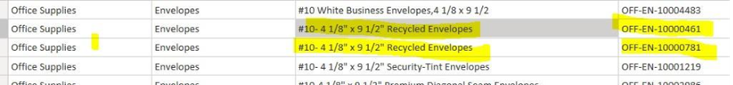
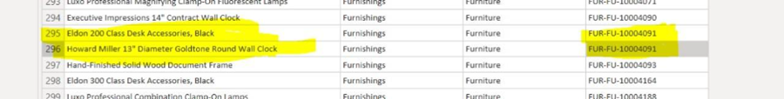
DATA PREPARATION & MODELING SECTION
Removed duplicates across Product IDs and Names.
Cleaned inconsistent product identifiers.
Formatted dates & added Year/Month/Quarter columns.
Checked sales/discount outliers.

Slide 12

Product ID Issue & Solution
Problem: Same product name with multiple IDs & vice versa.
Caused incorrect Many-to-Many relationships.
Solution:
Rename original ID → Product Serial
Create new unique Product ID using initials + serial
Ensure proper 1-to-many modeling

Slide 13


Power Query Transformations
Data Model (Star Schema)
Product ID creation
Date extraction
Filtering duplicates
FactSales
DimProduct
DimCustomer
DimRegion
DimDate

Slide 14

DAX Sample Measures:
Total Sales
Sales Growth %
YTD Sales
Profit Margin %

Slide 15




















DASHBOARD WALKTHROUGH SECTION

Slide 16
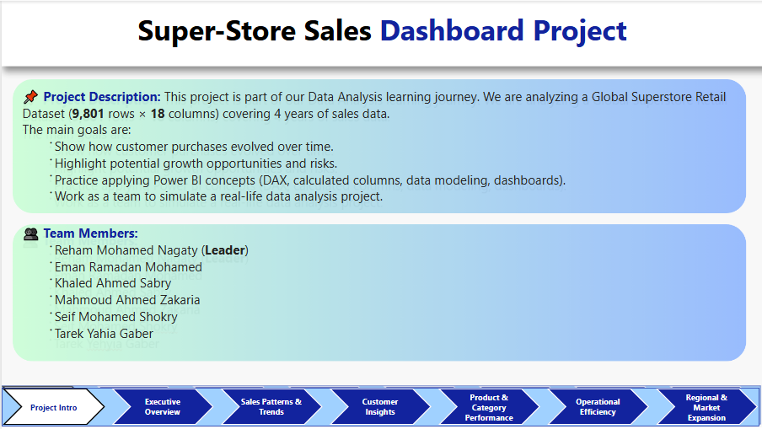
Project Intro

Slide 17
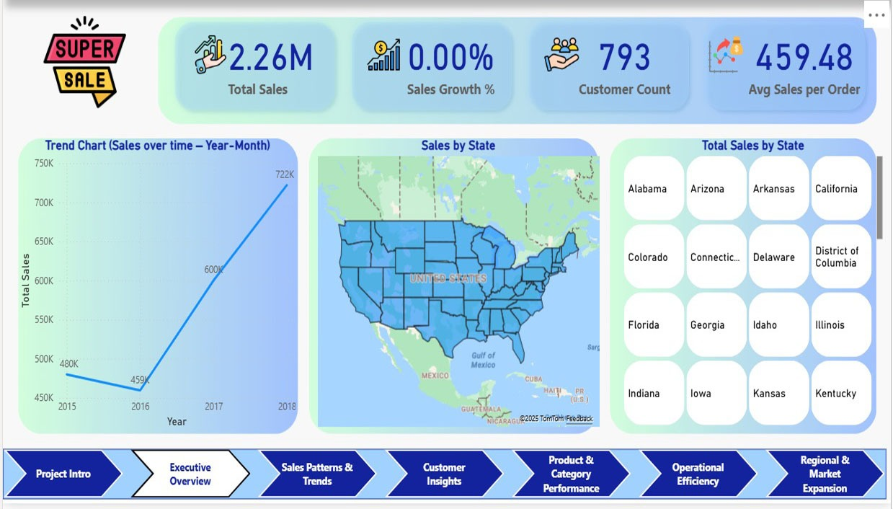
page 1: Executive Overview
Objective: Provide quick insights and act as main navigation Hub

Slide 18
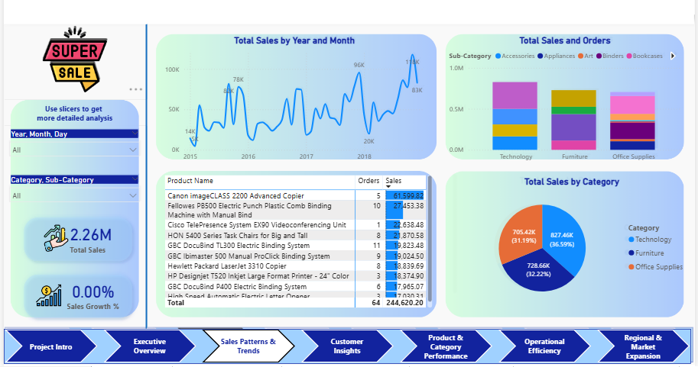
page 2: Sales Performance
Objective: Explore detailed sales patterns and trends.

Slide 19
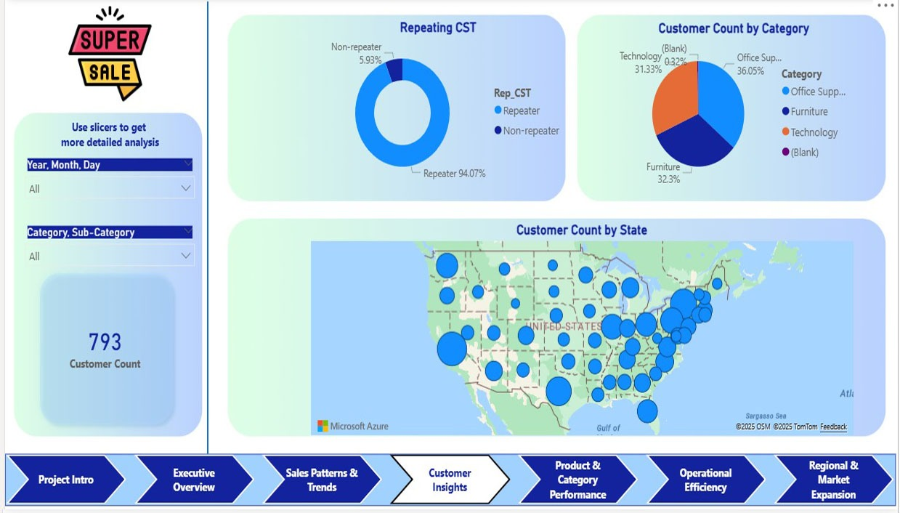
page3: Customer Insights
Objective: Evaluate customer base, retention, and segment contribution.

Slide 20
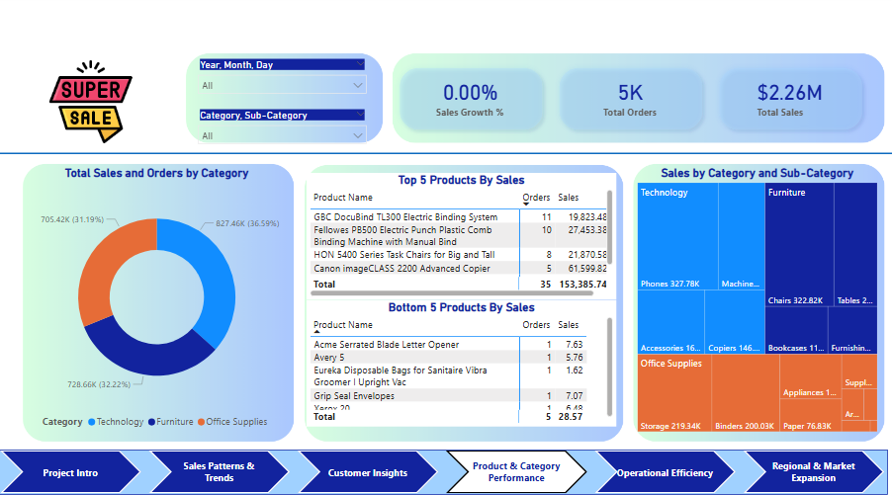
page 4 : Product & Category Performance
Objective: Identify profitable and underperforming products.

Slide 21
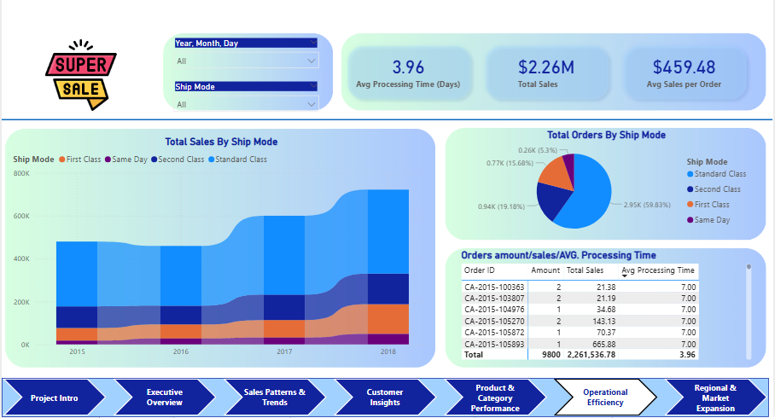
page 5 : Operational Efficiency
Objective: Assess shipping performance and order cycle time.

Slide 22
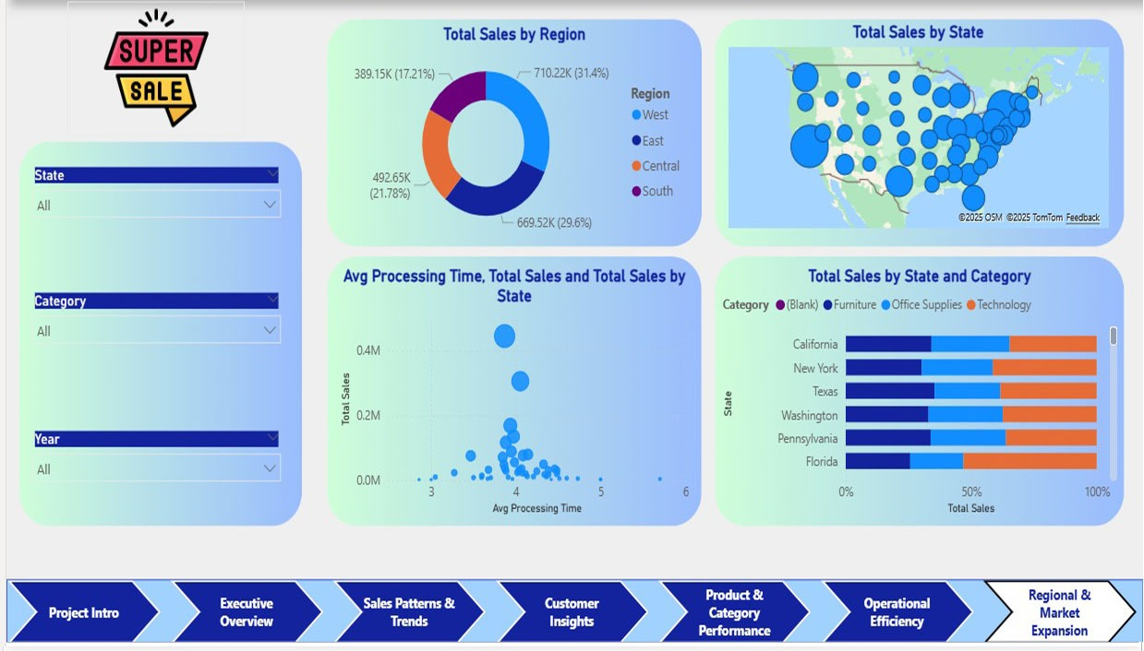
page 6 : regional & Market Expansion
Objective: Identify high-growth and declining markets.

Slide 23

Thank you very much!

